Slide 1



Phase-I Trigger Readout Electronics Upgrade for the ATLAS Liquid-Argon Calorimeters
TIPP17 – ? MAY 2017
Alessandra Camplani – Universita’ degli studi and INFN Milano
On behalf of the ATLAS Liquid Argon Calorimeter group

Slide 2
Outline
Introduction
LHC, ATLAS, LAr
Phase I Upgrade
LAr Front End Electronics
LAr Back End Electronics
Demonstrator
LAr Demonstrator
Baseplane and LSB
Front End: LTDB
ASICs
Development
Back End: LDPS
AMC
Carrier
Summary

Slide 3
Introduction

Slide 4
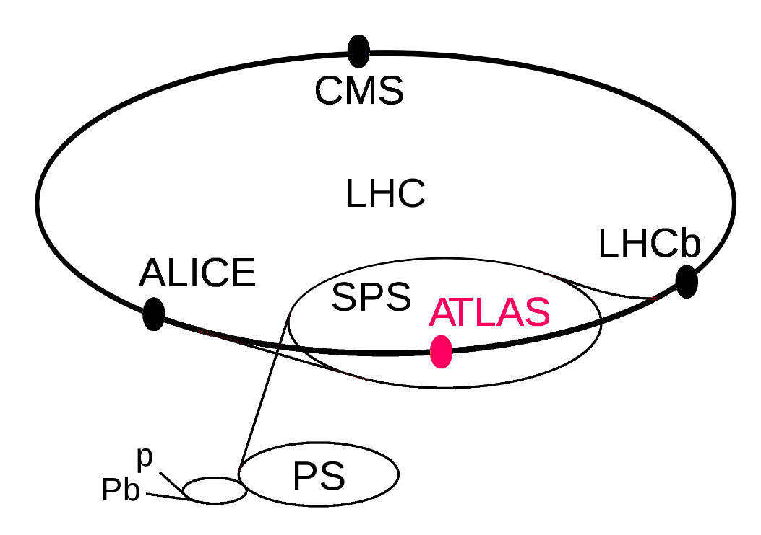
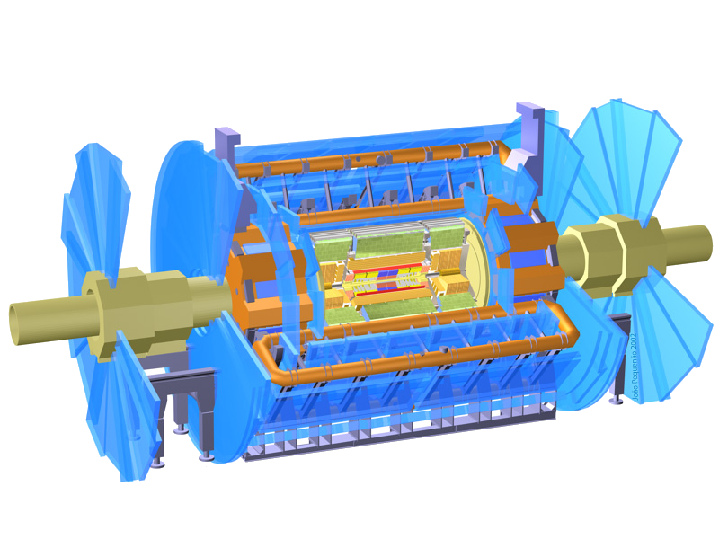
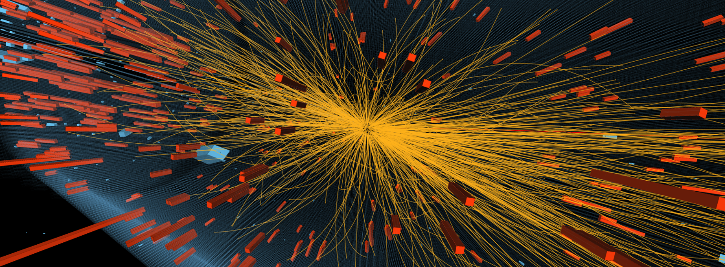
Context – LHC and ATLAS
Large Hadron Collider (LHC) at CERN, Geneva, Switzerland
27km circumference
depth between 50 to 175m
four collision points
ATLAS: A Toroidal LHC ApparatuS
46m long, 25m diameter and 7000 tons
Purpose:
Answer fundamental physics questions
Standard model

Slide 5
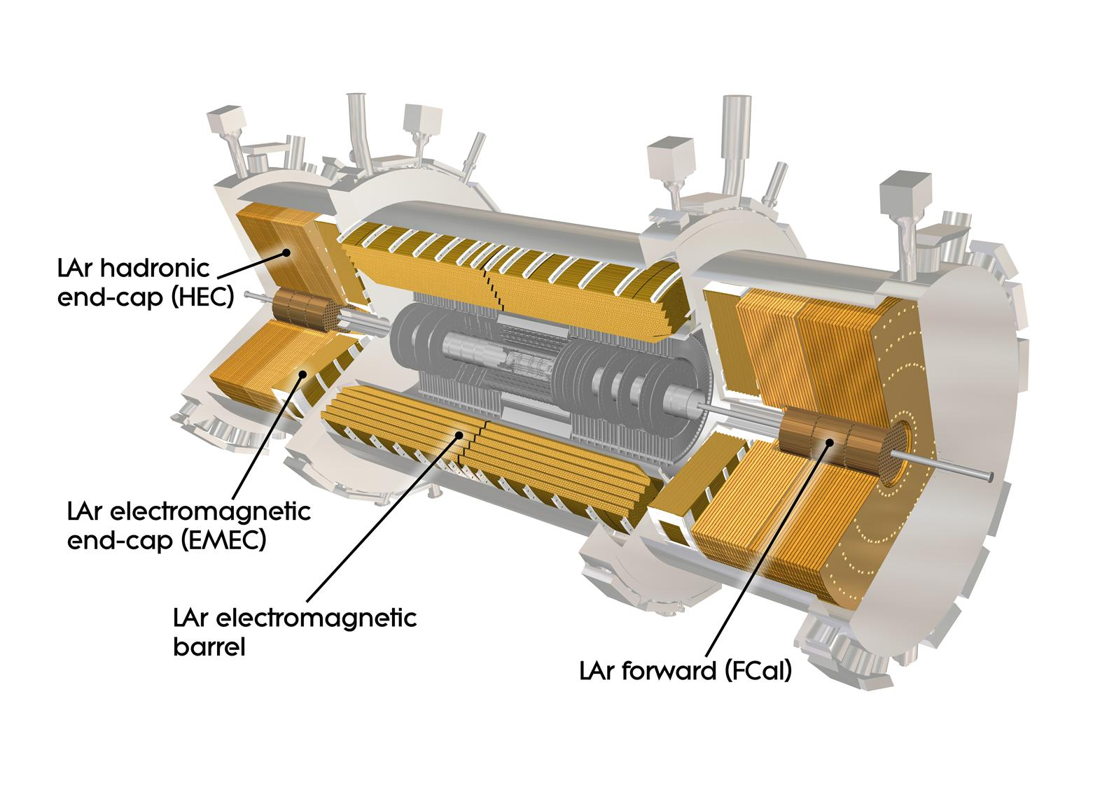
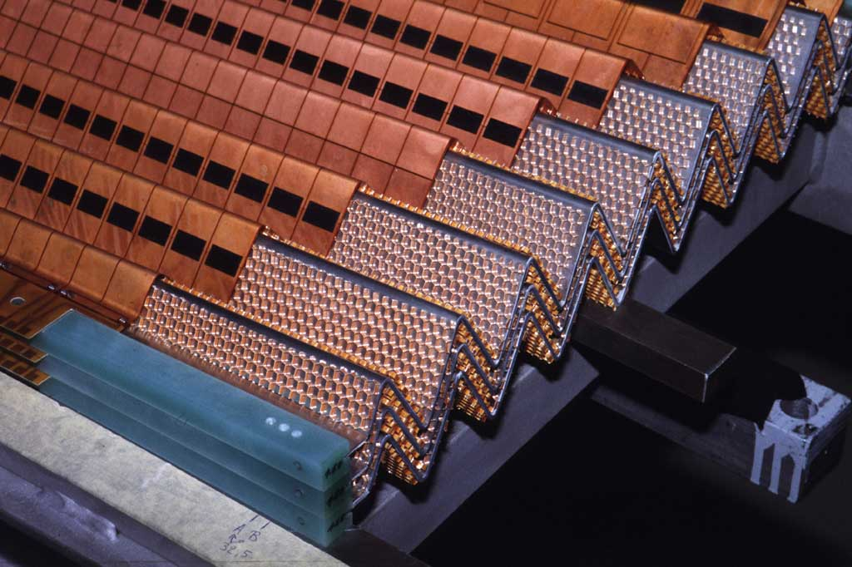
The Liquid Argon (LAr) Calorimeter
The LAr calorimeter is a sampling calorimeter with accordion-shaped lead absorbers and copper-kapton electrodes.
180K channels for the full readout of the electromagnetic (EMB+EMEC), hadronic (HEC) and Forward (Fcal) calorimeters
3K channels for analog Trigger readout
Front End crates: ≈ 1600 Front End Boards (FEB)
Back End crates: 200 Readout Out Driver boards (ROD)

Slide 6
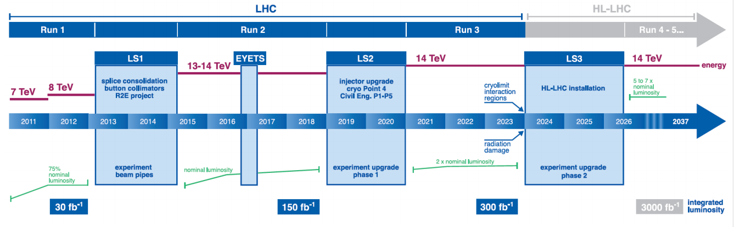
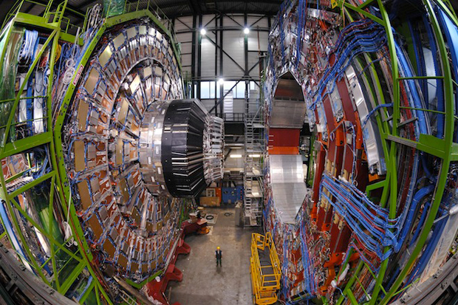
Why we need an upgrade
Increasing luminosity and increasing number of events
With the augmented luminosity the events (electrons and photons) selected by the calorimeter trigger would be about 270 kHz with the present system
This number must be reduced to 20 kHz
Isolation techniques at trigger level are not sufficient any more: some upgrades on the trigger are needed

Slide 7
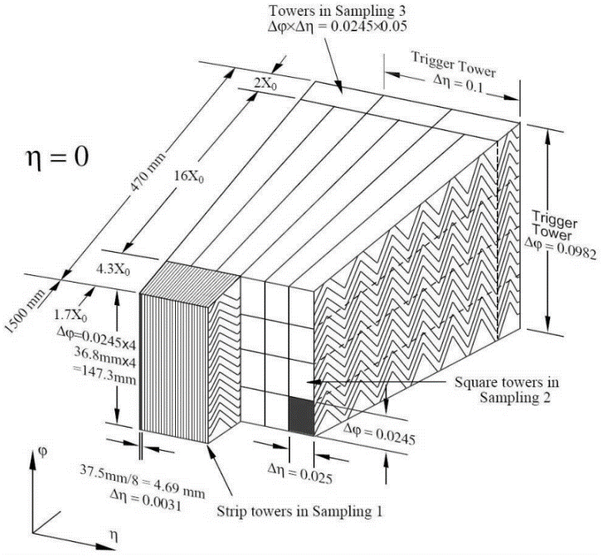
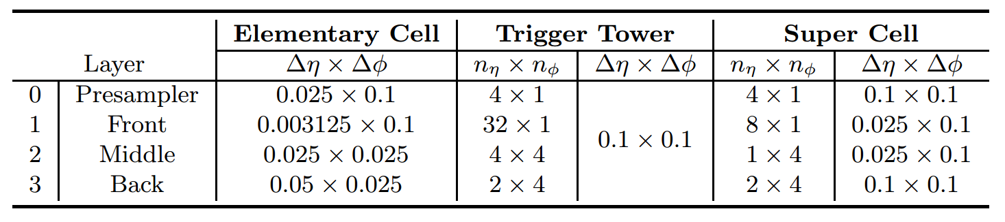
Calorimeter structure
Four layers: presampler, front, middle and back.
Each layer is made of elementary cells which correspond to the real calorimeter granularity
From the trigger point of view:
Towers: existing trigger granularity
Super Cells: Phase I trigger granularity

Slide 8
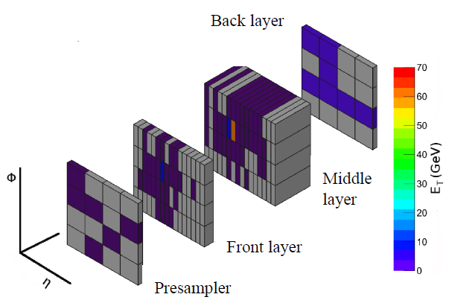
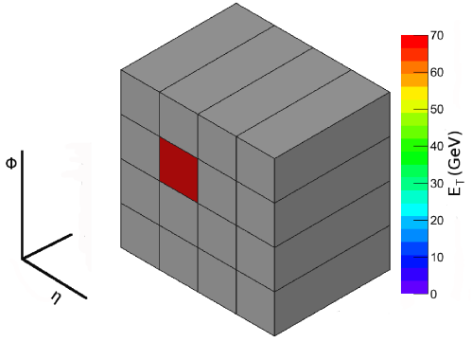
Calorimeter Upgrade
LAr Phase-I upgrade: new calorimeter trigger electronics with increased granularity and functionality for LAr calorimeter level 1 trigger
Trigger Tower
Super Cells
LAr Phase 1
Upgrade
Trigger Tower to Super Cells:
Granularity increased 10 times per each trigger tower
Provided information for each calorimeter layer for the full η range
Finer segmentation in the front and middle layers of the EM barrel and endcap
Higher resolution and shower information
Deal with the luminosity increase, maintaining a low-pT lepton threshold and keeping the same trigger bandwidth

Slide 9
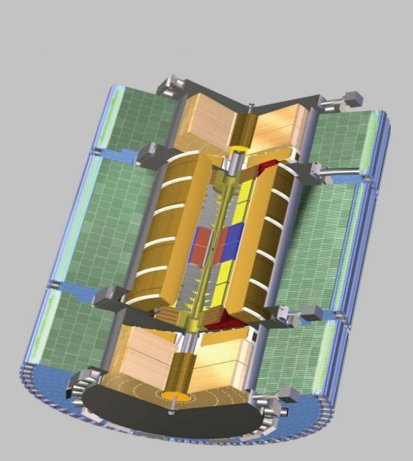
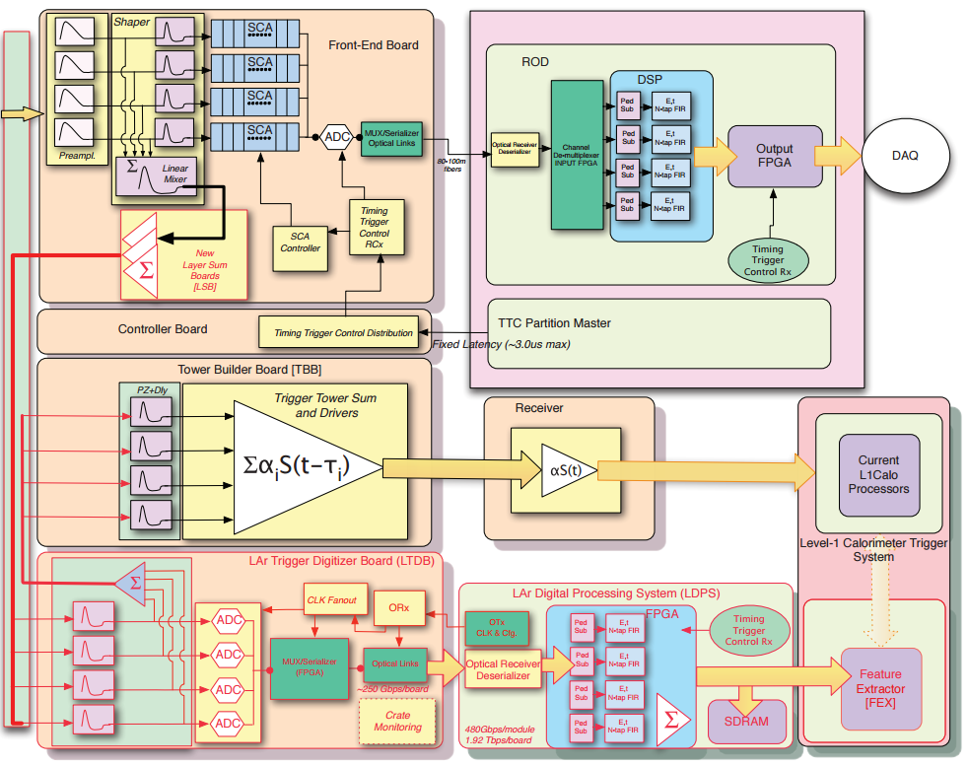
Current system
Schematic block diagram of the current LAr readout electronics architecture.
The LAr ionization signal proceeds upwards, through the FE crates mounted on the detector to the BE electronics in the USA15.
Electronics to be addressed
for Phase-I Upgrade

Slide 10
LAr Phase-I Project
Layer Sum Board
(LSB)
Baseplane
LAr Trigger Digitizer
Board (LTDB)
LAr Digital Processing System (LDPS)
New elements are highlighted in RED

Slide 11
LAr Phase-I Upgrade Project

Slide 12
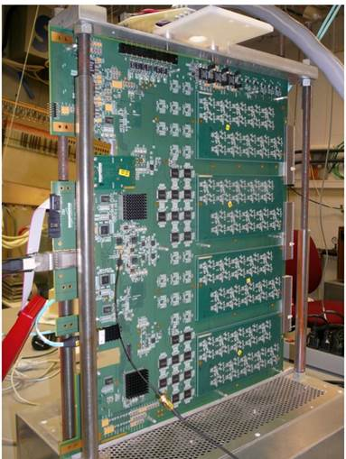
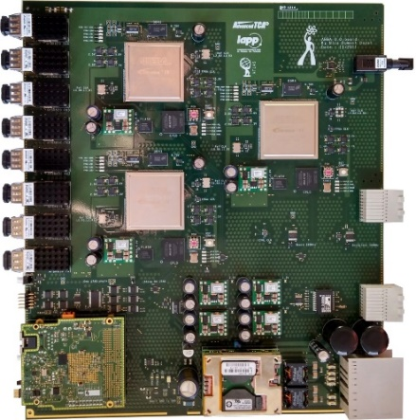
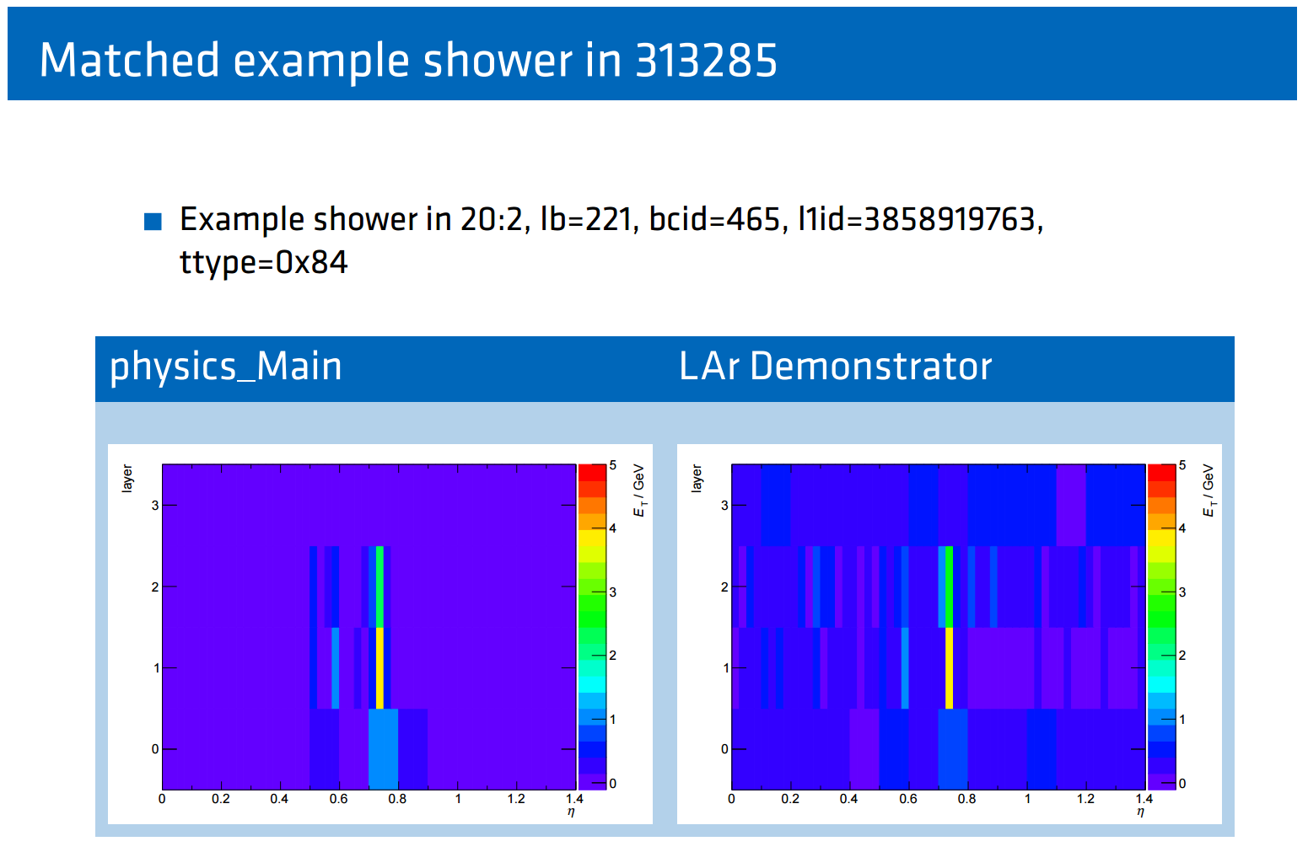
Demonstrator
Demonstrator installed in summer 2014
2 LTDBs readout via ABBA boards
Successful 2016 ATLAS pp data taking
No L1Topo during HI period
LArABBA partition active for some runs, triggering on Physics + Calo
Development and analysis works are making progress
Continuous development on firmware and software
Corrected latency shift happening during long runs
Introduce ID for tracing packets between FPGAs
Integration of ABBA as a new segment of ATLAS

Slide 13
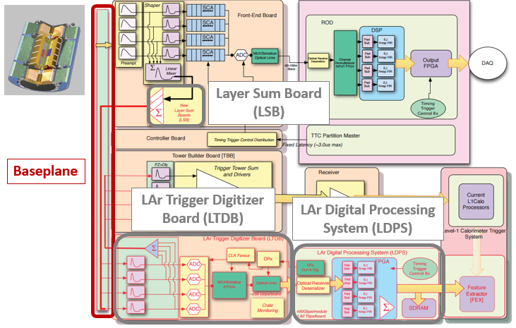
Baseplane
FDR of Baseplanes : 30 June 2015
EMB and EMECStd full contract awarded, first item to arrive around the end March 2017 (100 pcs)
PRR to release production around April 2017
HEC prototype done, advance testing, preparing production (8 pcs)
FCAL side A prototype under test. FCAL side C needs a modified design (2 pcs)
EMEC SP Prototype in fabrication (8 pcs)
Manufacturer identified for RF springs (original 2005 vendor dismissed), trying to pass full PO from CERN

Slide 14
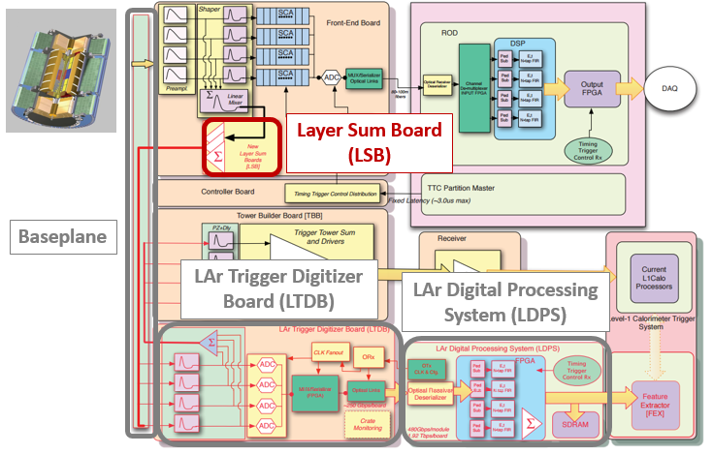
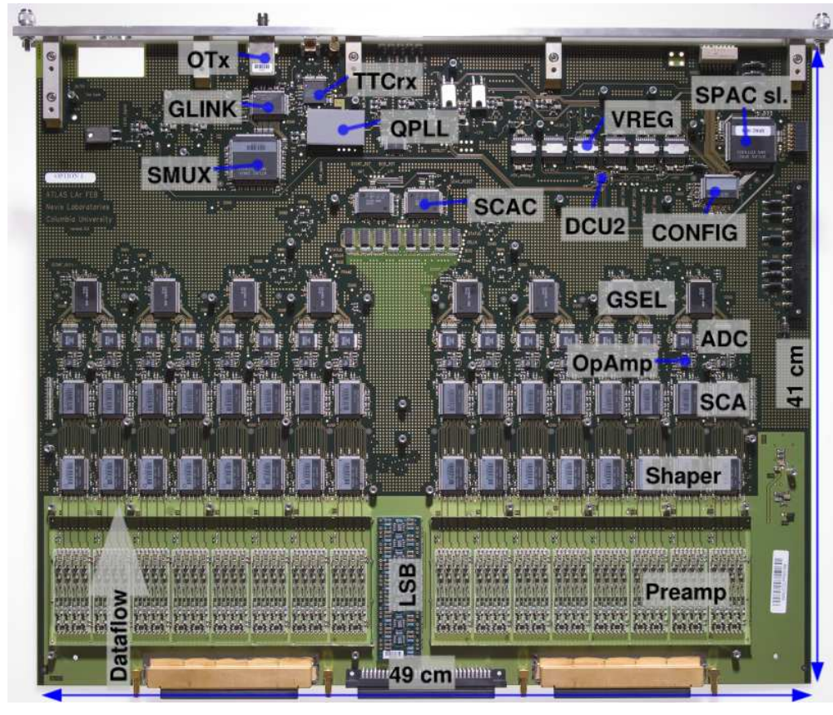
Layer Sum Board
FDR of LSBs: 30 June 2015
First part of LSB PRR on July 19 2016:
https://indico.cern.ch/event/547081/
Second part of LSB PRR on October 19 2016:
https://indico.cern.ch/event/574104/
All qualifications done
Single lot opamps ordered and arrived
LSBs production ongoing
FEB currently
installed
in USA15

Slide 15
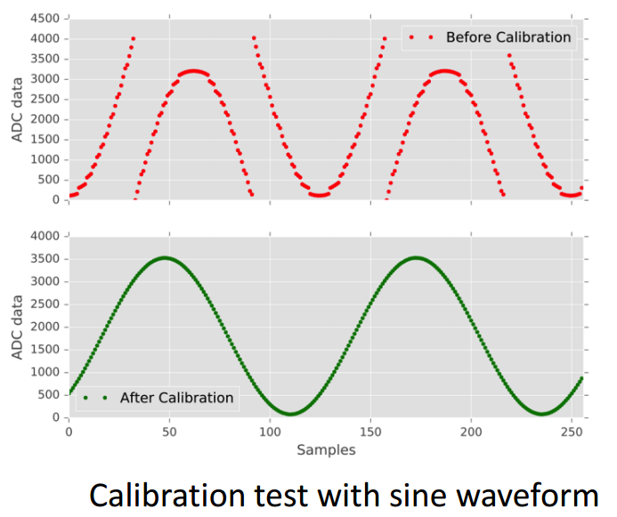
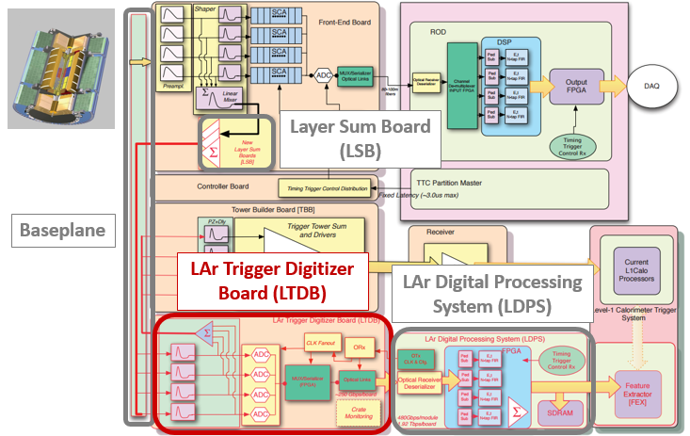
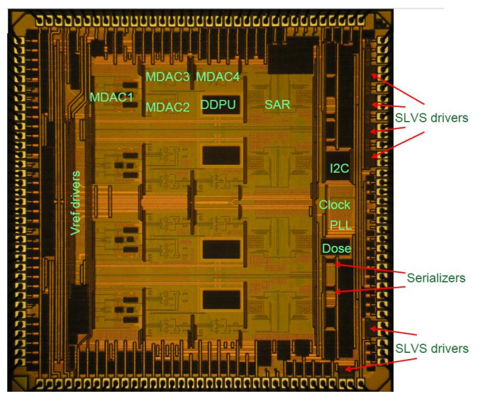
LTDB: ADC
PDR of ADC (May 2014) : use Nevis ASIC
Power, latency gain
Calibration test with sine waveform
Nevis13 - Nevis14: found digital issue (2015), ADC producing “bad codes” = “spikes” @~10 Hz
Nevis15 chip: “minimal” modification (no analog changes)
Available March 2016 and tested on 64 channels board: OK
QA to select good chips
Mini-production end 2016 for ~180 chips for the assembly of LTDB prototypes

Slide 16
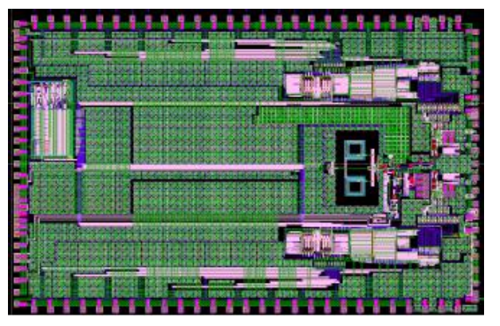
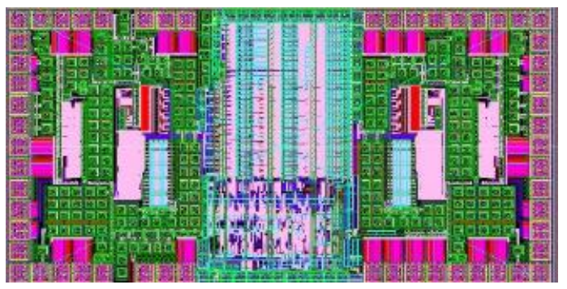
LTDB: LOCx2 & LOCld
Layout of the LOCx2 ASIC
LOCx2 (Serializer) / LOCld (opt. Link)
Baseline option 250 nm SOS (Silicon On Sapphire)
4 different processed wafers received on August 2016 : OK, minor yield differences
Ordered full production of 20 wafers: 16/20 OK.
Dies starting to be packaged now.
Should have proof of functioning at the end of February
If all OK (yield ~> 50%), sufficient chips in hand next months
QA plans in preparation and radiation tests to be repeated
Layout of the LOCld
We had some issues on production in the past: - Started a backup solution with 130 nm CMOS technology - LArTDS: serializer based on GBTx Ip - Chips delivered, currently under test and first operation seems OK

Slide 17
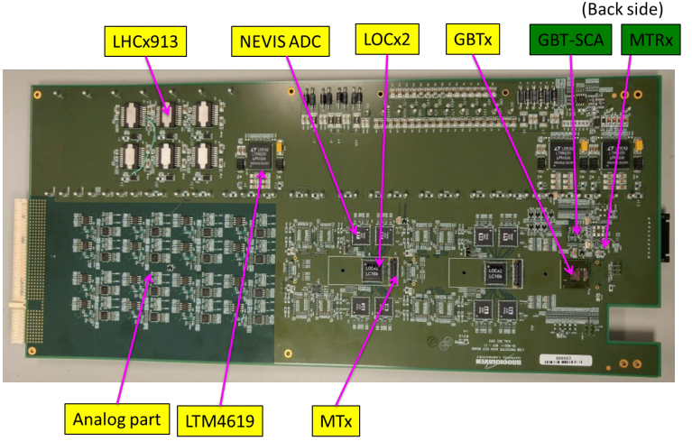
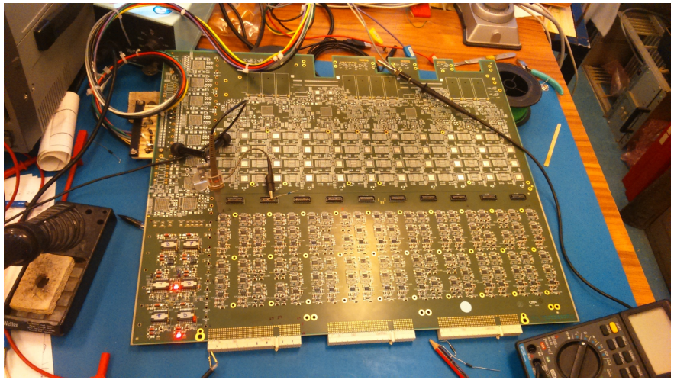
LTDB Development
LTDB 64ch prototype
Fully tested
Checked all chip control
GBTx, GBT-SCA, MTx, MTRx
Nevis14 - Nevis15
Also September LOCx2, all OK
Confidence building for 320 channels prototype
LTDB pre-prototype 320ch
Design Integration learning
Large board manufacturing
Analog performance check @ Saclay
Digital Readout tested at BNL with FELIX board

Slide 18
LTDB Development (2)
LTDB prototype
Gerber merged at the end of December
Some delay came from details Milano/Saclay/BNL for the PDB (Power Distribution Board) pins + monitoring signal
PCBs received Jan 31st. Board expected end February
Tests in ~March @ BNL, @ Saclay
AIM: 2 LTDB prototypes could be used to replace LTDB demonstrators in January 2018
Power Distribution Board (PDB)
Previous design based on FEAST device from CERN, current design based on LTM4619 (COTS), development on going (Milano)
PDB design and submission by end February 2017
Joint test LTDB-PDB (expected April 2017) will define FE reviews
FDR of LTDB, PRRs of ASICS (~May 2017)

Slide 19
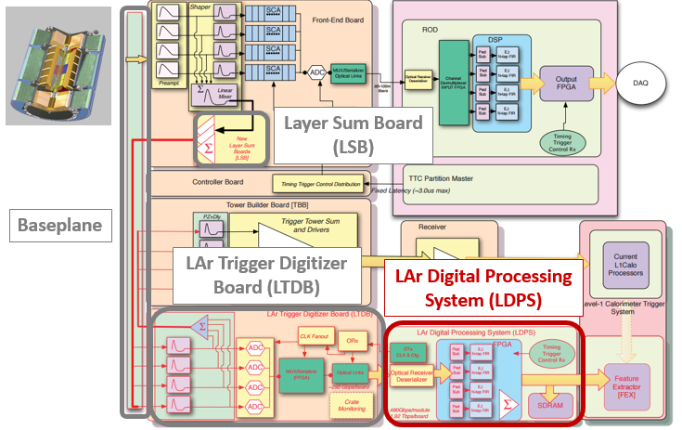
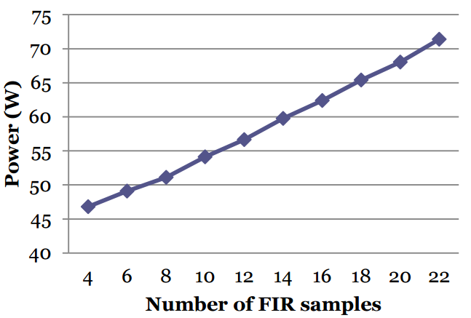

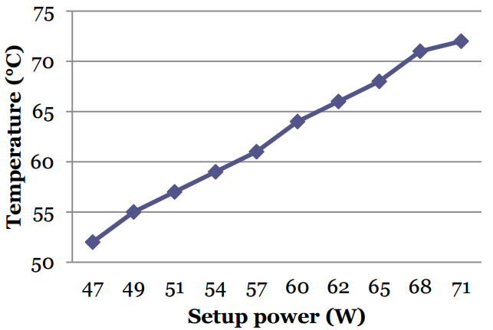
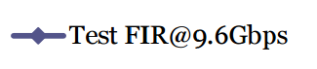
LDPS Development
LATOME V2
LATOME
Based on Altera Arria10 FPGA
LATOME V1 is working, but with some power issues
Design has been updated
LATOME V2 ready at the end of 2016: is working fine and power issue seem fixed
FPGA core current decreased
Setup power decreased -> More firmware for the same power
Fibers: work in progress for pre-series
Setup power / Nb of FIR samples
LATOME V2
Carrier board V1 2015, FDR passed with AMC
V2 available since Spring 2016
On board Ethernet HW chip
V3 already assembled
Test ongoing
To be used in further integration
FPGA temperature / Setup power
LATOME V2

Slide 20
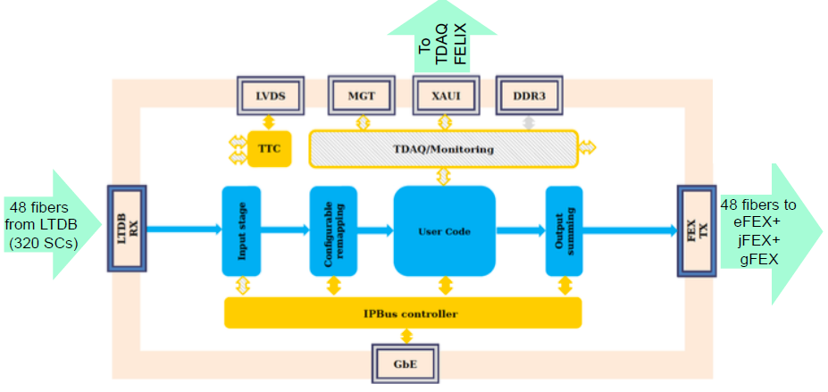
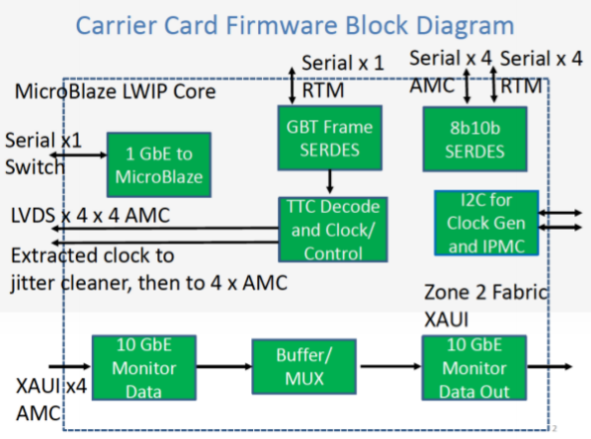
LDPS Firmware
LATOME firmware development ongoing
Block deliverables:
Seven groups contributing
Emphasis on simulation and integration
Latency and resources verified at each major step
Adapt to System Test milestones : implement on HW
Carrier firmware development ongoing
Development of Carrier firmware continues with emphasis on completing a baseline project
Testing of Carrier hardware and firmware at EMF will be ongoing (TTC, 1GbE, 10GbE etc.)
Stability issue of uBlaze project to be addressed

Slide 21
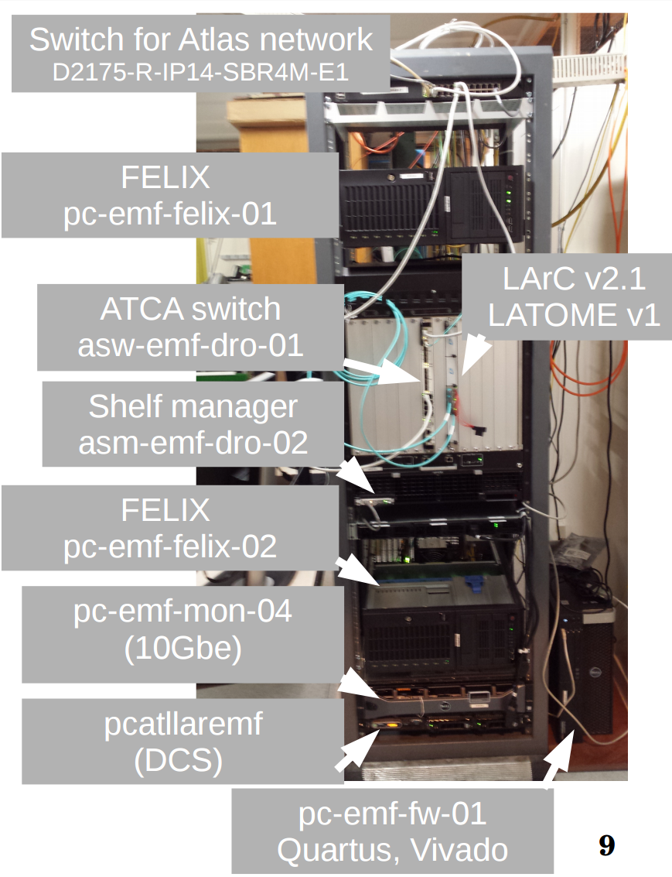
Back End System Test
Demonstrate feasibility of BE system
Pass PRR for releasing series board production
Show operation of all parts of system
Verify operation of FPGAs
Test Power-Cooling in ~final conditions
Boost coding, testing and debugging of FW
Boost coding, testing and debugging of Online SW (incl. TDAQ)
Eventually connect to LTDB
Full system test
Several milestones have been reached: moving forward for the next steps
PRR expected in late spring

Slide 22
Summary

Slide 23
Summary
LAr Demonstrator has successful 2016 ATLAS pp data taking
Preparation for 2017 run has started
Baseplane is making progress
Manufacturer identified for RF springs, trying to pass full PO from CERN
LSBs production ongoing
Passed PRR in October successfully
Front end LTDB
Nevis15 ADC tested on 64 channels board and OK, plan to address it by QA
LOCx2 16/20 wafer are ok, proof of functioning at the end of February
LTDB board development is progressing well with baseline design: FDR by spring 2017
Back end LDPS
LATOME V2 much improved in terms of power, temperature and voltage drop vs V1
cabling of 13 boards in process and fibers being ordered
12 LATOME V2 boards should be available for the system test by end of March
Carrier V3 assembled and test ongoing
Firmware development is making good progress and BE system integration is marching to the next major milestone

Slide 24
Backup slides

Slide 25
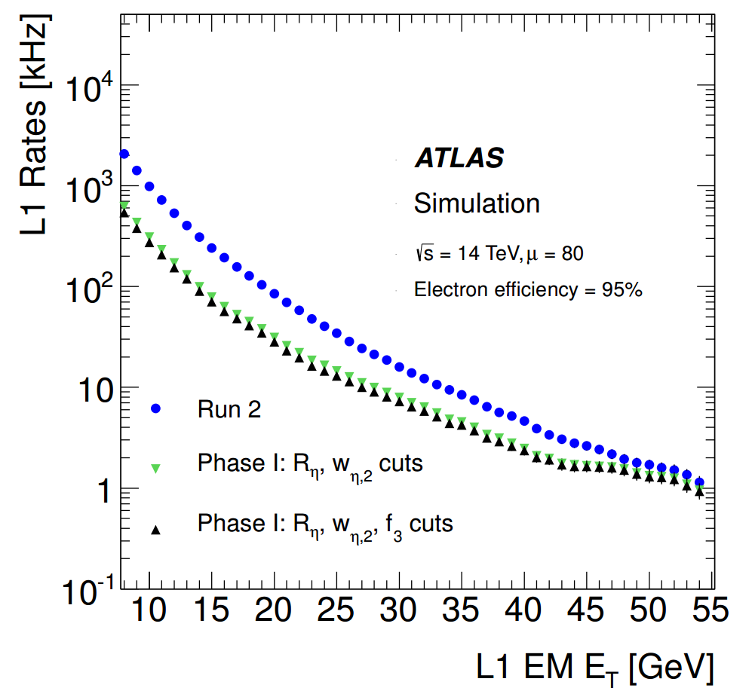

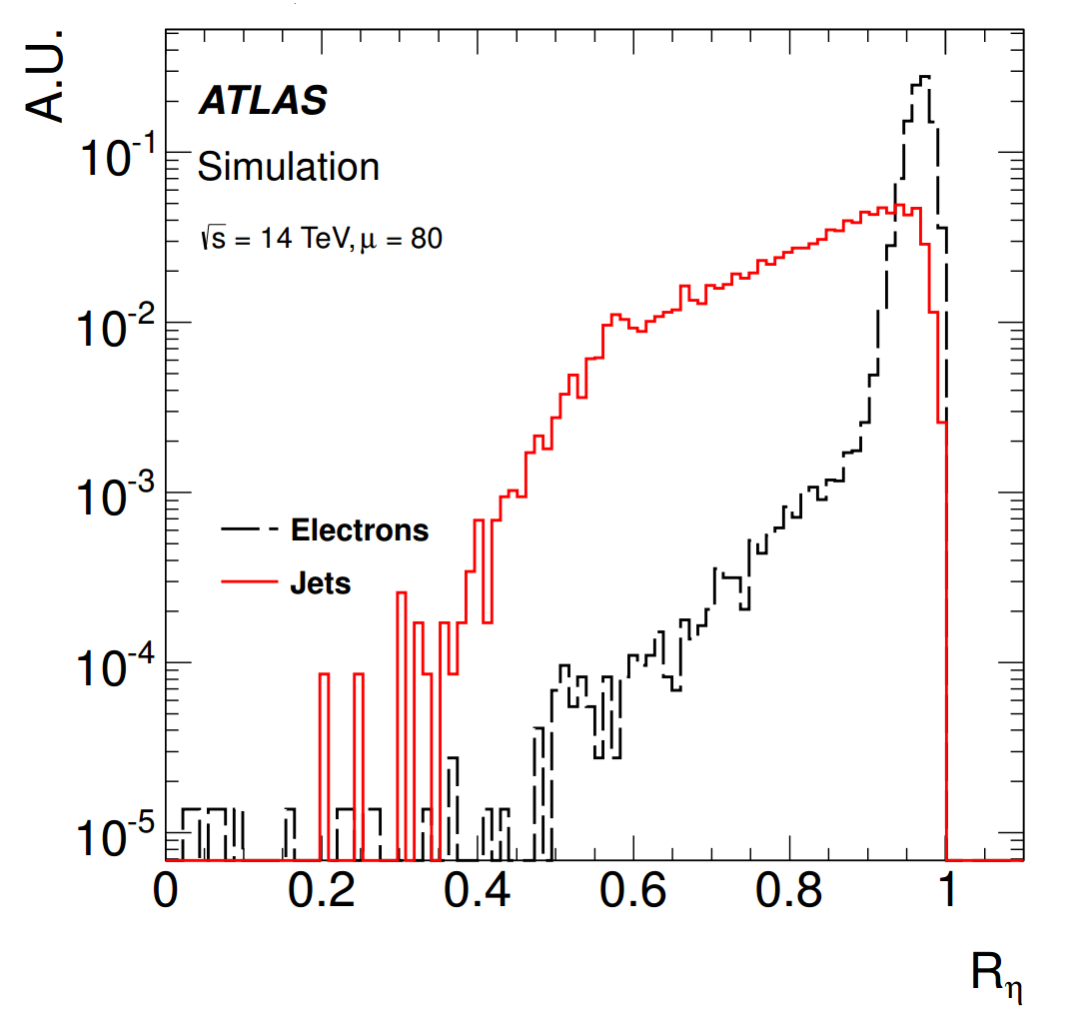
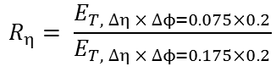
Motivation and strategy
Main goals: deal with the luminosity increase, maintaining a low-pT lepton threshold and keeping the same trigger bandwidth
With the new Phase-I electronics:
Make use of shower shape variables: a more sophisticated rejection of jet backgrounds
Level-1 threshold for a given bandwidth of e.g. 20 kHz (28.5 GeV assuming Run 2 conditions) could be lowered by 7 GeV
$$R_{η}= \frac{E_{T, ∆η × ∆ϕ=0.075×0.2}}{E_{T, ∆η × ∆ϕ=0.175×0.2}}$$
Ratio between the transverse energy of a Super Cells group of dimension 3x2 and the transverse energy of a group 7x2.
Ratio
2.5
~
ΔET
~
7 GeV

Slide 26
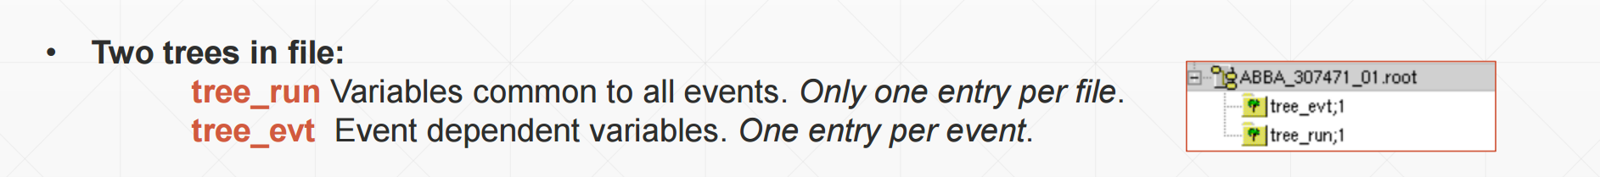
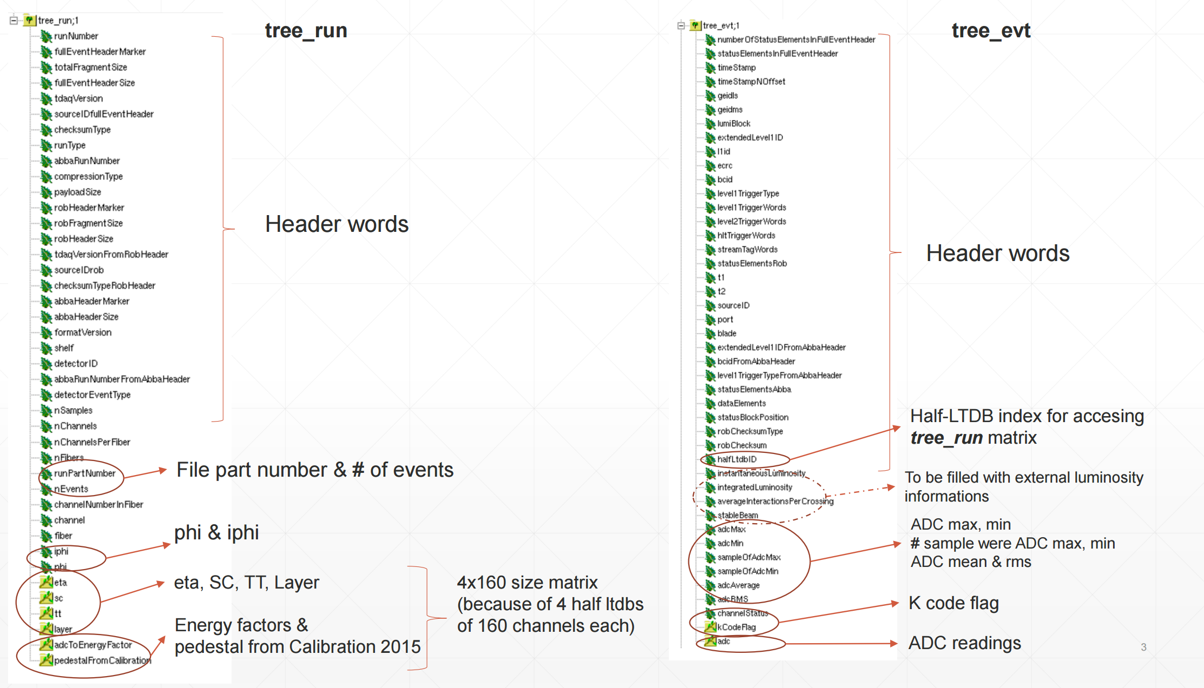
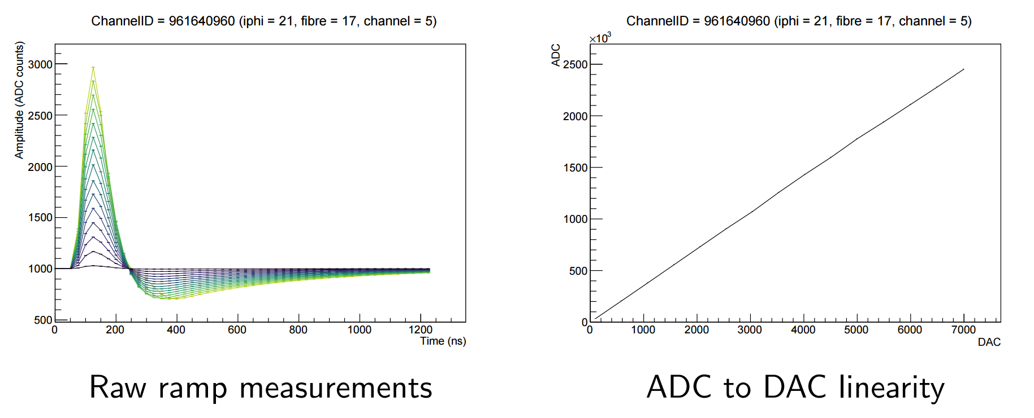
LAr Demonstrator
Development and analysis works are making progress
Continuous development on firmware and software
Corrected latency shift happening during long runs
Introduce ID for tracing packets between FPGAs
Integration of ABBA as a new segment of ATLAS
Calibration data taking has been carried out
New Ntuples format for demonstrator data

Slide 27
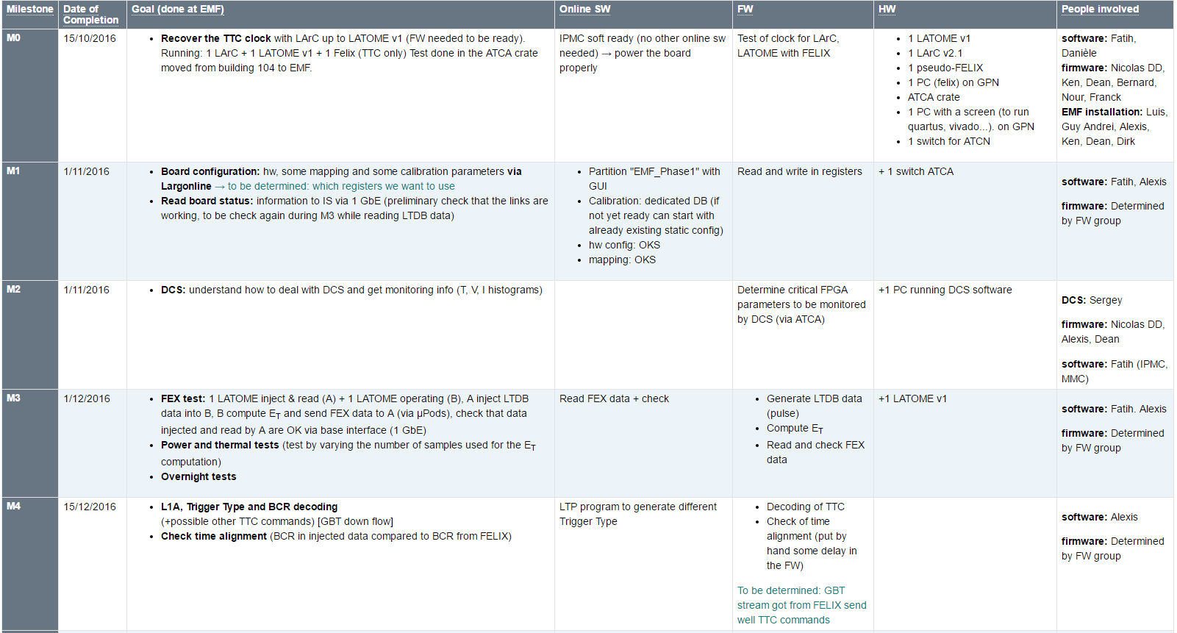
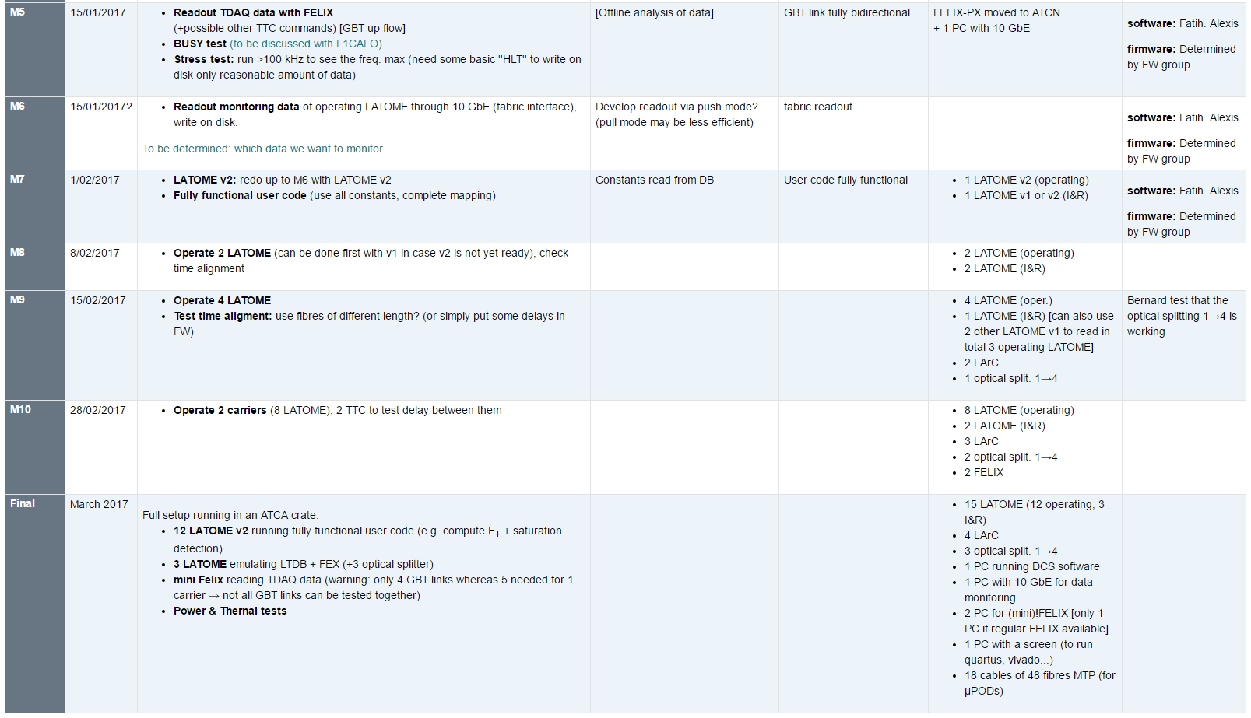
Back End System Test
ST-M0 completed on November 2016
Clock from FELIX well recovered on LArC and LATOME
ST-M1 had a slight delay, ~OK on January 2017
Good progress on firmware and software side to R&W in registers via 1GbE
DCS monitoring completed for ST-M2 on December 2016
ST-M3 will be the next major milestone: planned for March 2017
Inject LTDB data, and readout FEX data for comparison
ST-Mxx to M11: the last one to be completed ~Fall 2017

Slide 28
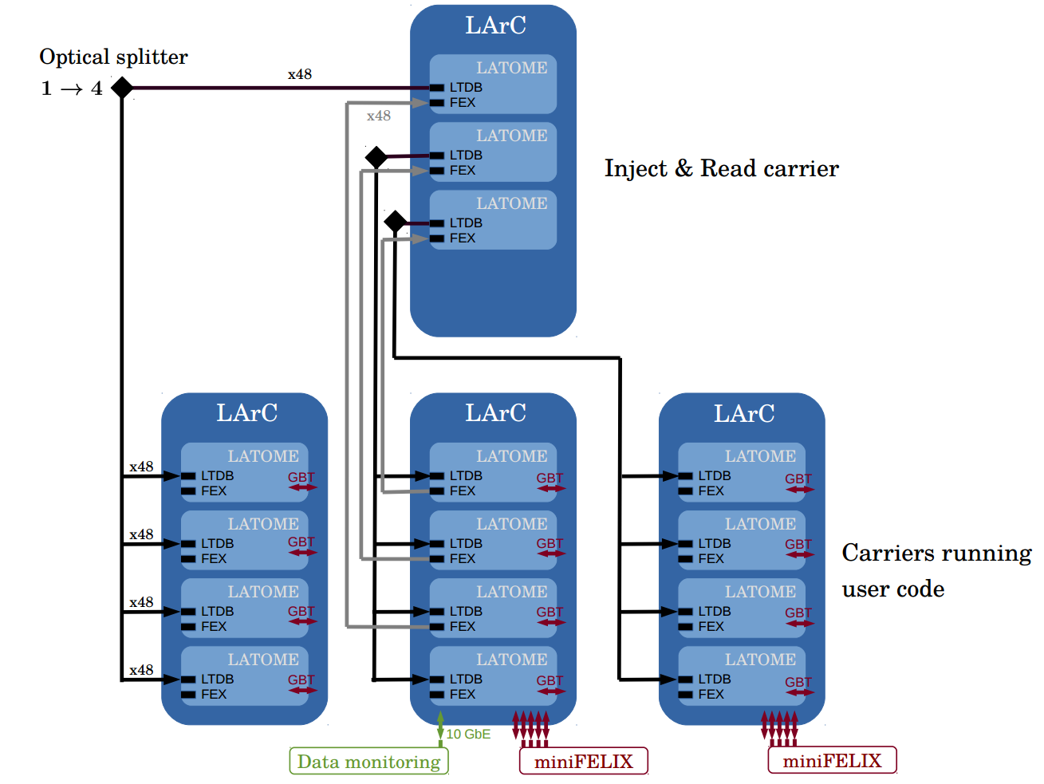
Test setup
1 carrier :
Inject « LTDB » data
Read « FEX » data
→ data verification
3 optical splitters 1→4 : feed the 3 other carriers
3 carriers running user code :
compute E_{T} for L1 (FEX)
Send data to TDAQ via FELIX
TTC signal via FELIX
Data Monitoring via 10 GbE
Test done at EMF

Slide 29
Number of boards
LTDB : 124
LAr Carrier : 31
LATOME : 124

Slide 30
Planning (1)

Slide 31
Planning(2)

Slide 32
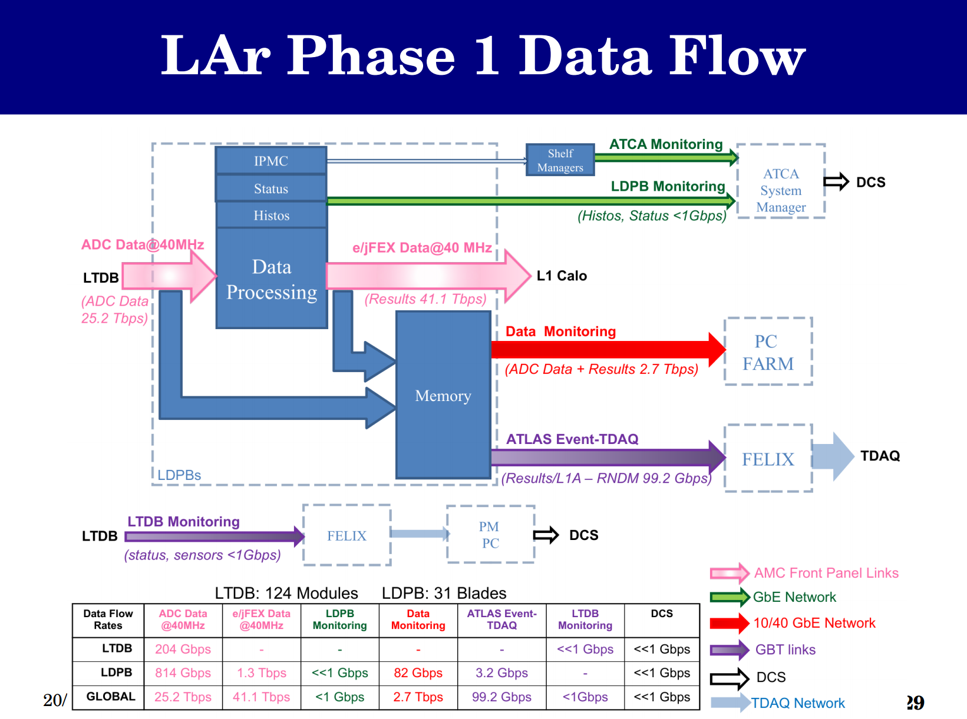
Phase-I Data Flow

Slide 33
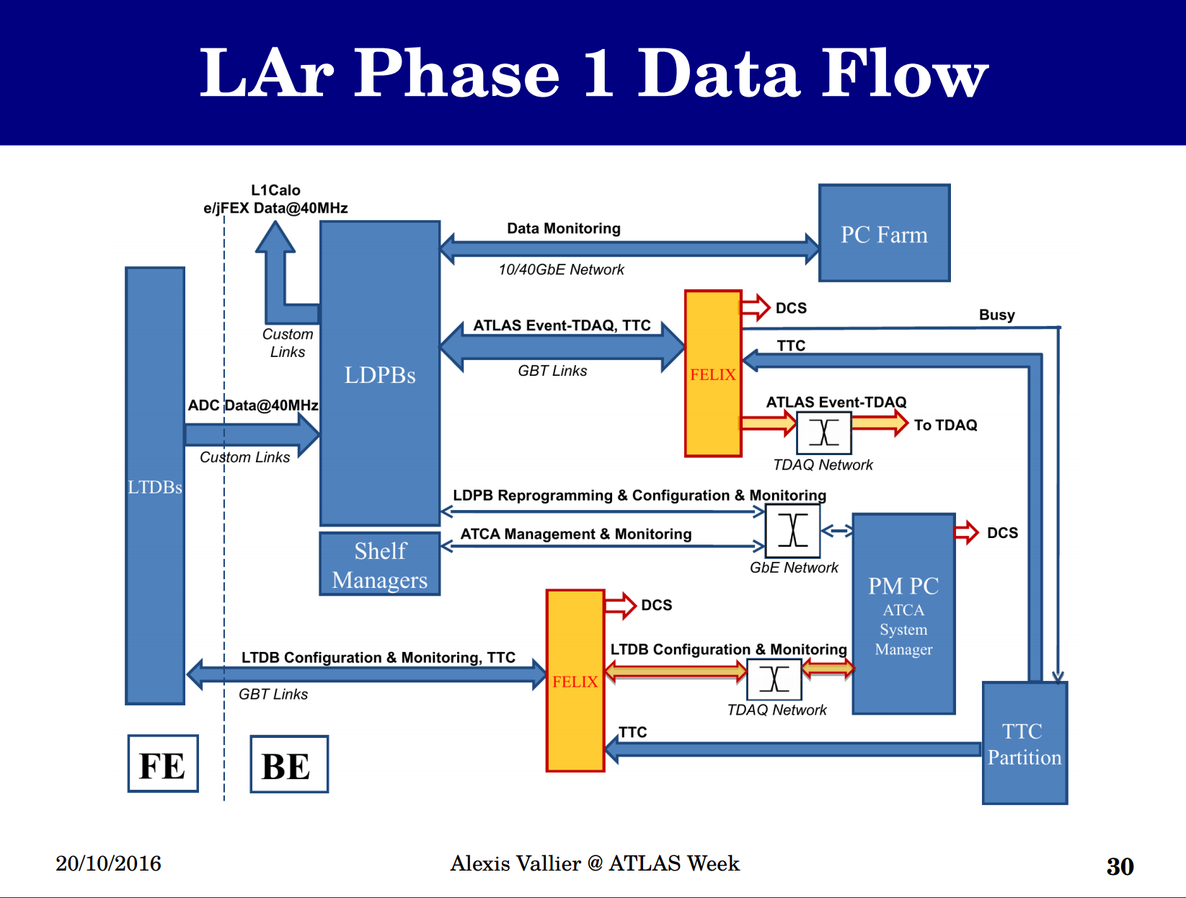
Phase-I Data Flow

Slide 34
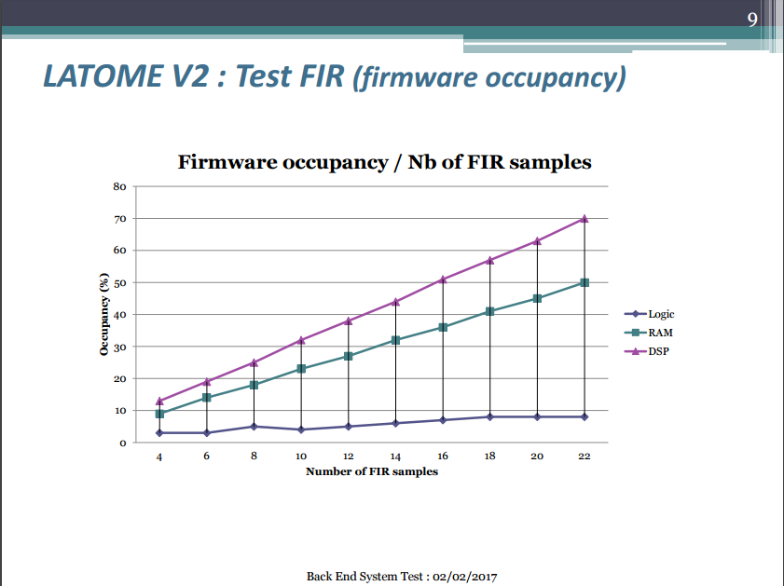
Nicolas Dumont Dayot

Slide 35
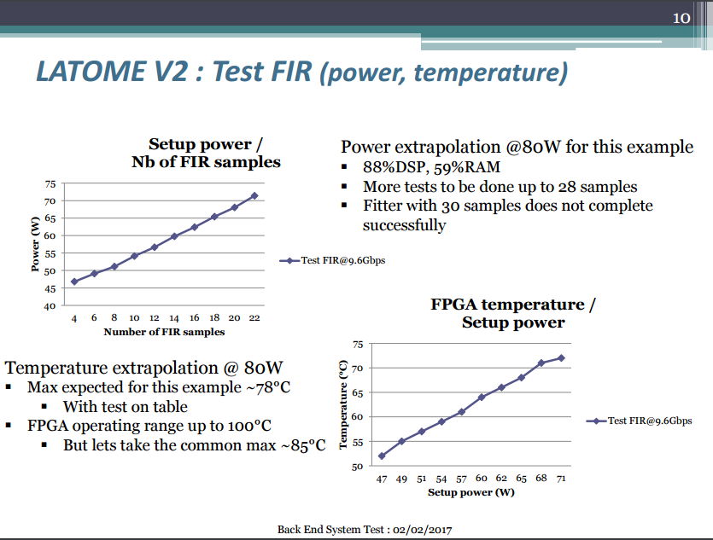
Nicolas Dumont Dayot
Nicolas Dumont Dayot

Slide 36
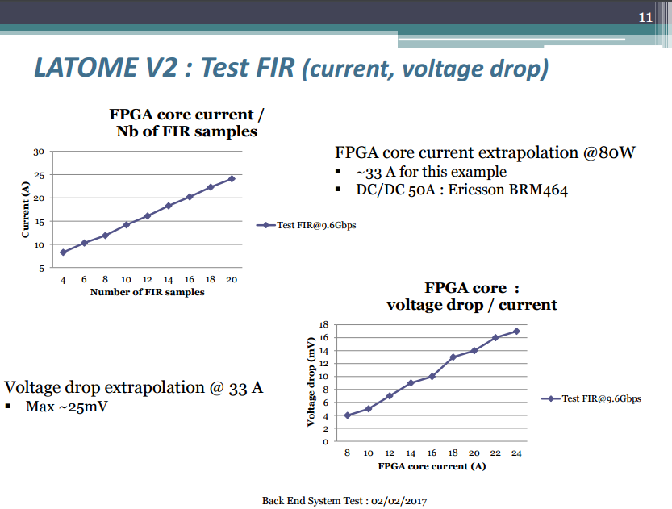
Nicolas Dumont Dayot

Slide 37
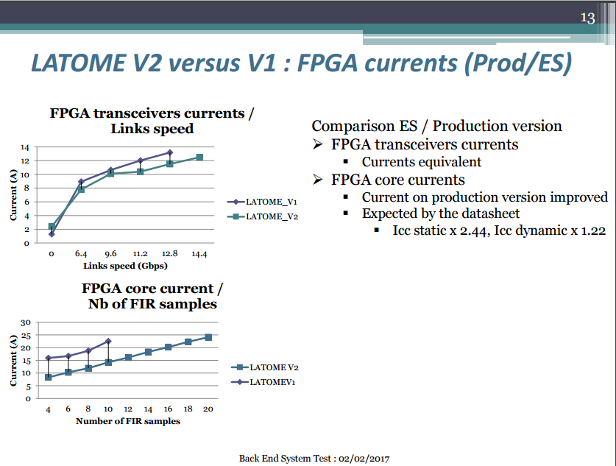
Nicolas Dumont Dayot

Slide 38
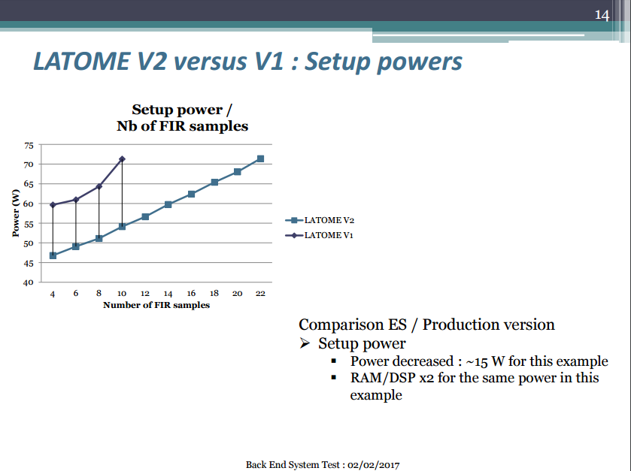
Nicolas Dumont Dayot

Slide 39
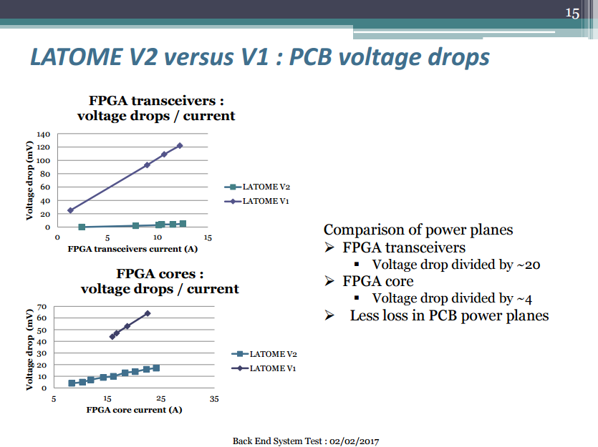
Nicolas Dumont Dayot

Slide 40

Nicolas Dumont Dayot

